Slide 1

Sentiment analysis and hotel reviews
Mikko roimaa
Miika pernu
Pilvi tunturi

Slide 2
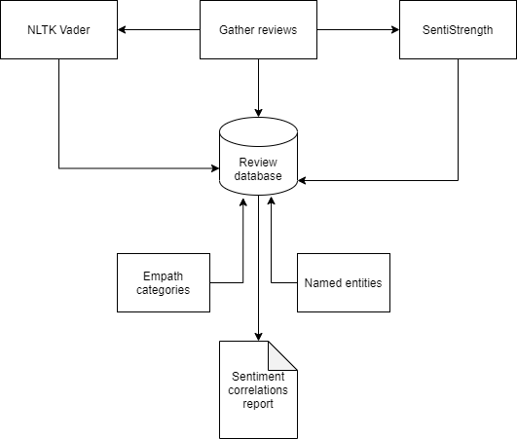
The goal
This project aims to investigate the sentiment and test various architecture for argumenting the sentiment polarity (positive, negative, neutral). We will compare various sentiment analyzers and contrast evidence from individual raters. The tool comparison will be done using SentiStrength as a given tool and NLTK Vader sentiment. We will compare how these tools are able to correlate the sentiments of user’s reviews and each other. What are the strengths and weaknesses of those tools and how do they perform overall compared to each other. What kind of categories relate to each review and how do they correlate to positive or negative sentiments. What kind of named entities each review has and how do their presence correlate to the positive or negative sentiments. Finally, we will deep dive into ambiguous class, what do they contain. How does the word count correlate to ambiguousness and what kind of reviews can be cleaned up as ambiguous by comparing the word’s existence in a standard dictionary.

Slide 3
Relevant prior work
Relevant prior work (paper citations, actual systems)
https://drops.dagstuhl.de/opus/volltexte/2016/6008/pdf/OASIcs-SLATE-2016-3.pdf Comparing the Performance of Different NLP Toolkits in Formal and Social Media Text∗
https://www.researchgate.net/profile/Ammar_Hassan6/publication/273000042_Benchmarking_Twitter_Sentiment_Analysis_Tools/links/54f484d70cf2ba6150634593.pdf
https://hci.stanford.edu/publications/2016/ethan/empath-chi-2016.pdf empath: Understanding Topic Signals in Large-Scale Text/11
https://www.cs.uic.edu/~liub/publications/kdd04-revSummary.pdf Mining and Summarizing Customer Reviews

Slide 4
Topics investigated
Using SentiStrength for polarity (positive, negative, neutral)
Using AWS Comprehend to analyse the data
Using NLTK Vader for polarity
Empath client and named entity tagging tools using python
Data visualisation

Slide 5
Project overview
Group member responsibilities:
Miika
Mikko
Pilvi
Data sources:
https://www.kaggle.com/datafiniti/hotel-reviews (Datafiniti_Hotel_Reviews_Jun19.csv)
Python nltk.downloads
Technologies used and existing tools leveraged:
Python (Jupyter notebooks)
AWS Comprehend
SentiStrength
NLTK Vader
QT (GUI)

Slide 6
Current results so far
AWS Comprehend seems to require AWS Glue and AWS Athena for data management. Getting expensive with the amount of data so far.
…

Slide 7
To do
Named entities to files
Combine analysis files with ids
Update GUI
Create report
Create presentation
W43
W44
W45

Slide 8
questions
How are the models trained? Are they applicable for hotel reviews (https://www.win.tue.nl/~aserebre/ICSME2015ERARobbert.pdf study of using sentistrength and nltk to software engineering sentiment analysis)
Do the tools agree on the results?

Slide 9
Jutellaan tästä huomenna
Measurement criteria are essential
Creating a cool application is great but not sufficient – you also need a predetermined standard for evaluating the success or failure of your work. So, keep in mind to bring motivation ground when writing your report
Some kind of scientific numerical analysis of your system’s performance in comparison to a baseline or rival system:
precision/recall
user satisfaction ratings
correlation or mean squared error (if you’re predicting values)
processing time, main memory requirements, disk space
Etc

